Slide 1

Memory address map; Memory connection
Computer Organization and Architecture | Memory & I/O Organization
Course: Computer Organization and Architecture | Chapter: Memory & I/O Organization | Program: Bachelor of Engineering
DISCOVER · LEARN · EMPOWER
Notes:
Welcome students to today's lecture on Memory and I/O Organization. We will focus specifically on how the CPU maps addresses to physical memory locations and how these connections are physically established. This is a critical foundation for understanding system performance and data access speeds.

Slide 2
Course Outcomes
SLIDE 2 / 10
Course Outcome
CO | BT LEVEL | DESCRIPTION
CO1 | BT3 | Apply number systems and digital logic to design basic digital circuits
CO2 | BT4 | Analyze register organization and instruction set architecture
CO3 | BT3 | Implement computer arithmetic algorithms and floating-point operations
CO4 | BT5 | Analyze memory hierarchy and input-output organization
CO5 | BT6 | Evaluate control unit design and pipelining performance
Chandigarh University
2 / 10
Notes:
Today's session directly addresses Course Outcome 4, which requires you to analyze memory hierarchy and input-output organization. By the end of this lecture, you will be able to map logical addresses to physical memory and understand the hardware connections required for this process. This analysis is essential for designing efficient computer systems.

Slide 3
Learning Objectives
SLIDE 3 / 10
Learning Outcomes
1
Evaluate the structure of memory address maps in modern systems
2
Differentiate between memory-mapped I/O and isolated I/O schemes
3
Analyze the role of address decoders in selecting specific memory chips
4
Construct a memory connection diagram for a given address range
5
Calculate the number of address lines required for specific memory sizes
Chandigarh University
3 / 10
Notes:
Our goals today are to evaluate how address maps are structured and to differentiate between memory-mapped and isolated I/O. You will learn to analyze address decoders and construct connection diagrams. Finally, we will practice calculating the necessary address lines for various memory configurations.

Slide 4
Lecture
SLIDE 4 / 10
Memory Address Map Definition
1
A memory address map defines the range of addresses assigned to each memory chip
2
It ensures every byte in the system has a unique and accessible physical location
3
The map prevents address conflicts where two devices claim the same address
4
It acts as a blueprint for the CPU to locate data in RAM or ROM
5
Address maps are typically divided into blocks for RAM, ROM, and I/O ports
Chandigarh University
4 / 10
Notes:
Think of a memory address map as a city street map where every house has a unique number. If two houses had the same number, mail delivery would fail. Similarly, in a computer, the map ensures the CPU knows exactly where to find data without confusion. This blueprint is crucial for the system to function correctly.

Slide 5
Lecture
SLIDE 5 / 10
Memory-Mapped I/O vs Isolated I/O
1
Memory-mapped I/O treats I/O ports as part of the main memory address space
2
Isolated I/O uses a separate address space distinct from the main memory range
3
Memory-mapped I/O allows standard load and store instructions to access peripherals
4
Isolated I/O requires special IN and OUT instructions for peripheral communication
5
Memory-mapped I/O simplifies instruction sets but reduces available memory space
Chandigarh University
5 / 10
Notes:
In memory-mapped I/O, the CPU uses the same instructions to read data from a keyboard as it does from RAM. In contrast, isolated I/O requires special instructions like IN and OUT, keeping the address spaces separate. This distinction affects how the processor handles data transfer and how much memory is available for programs.

Slide 6
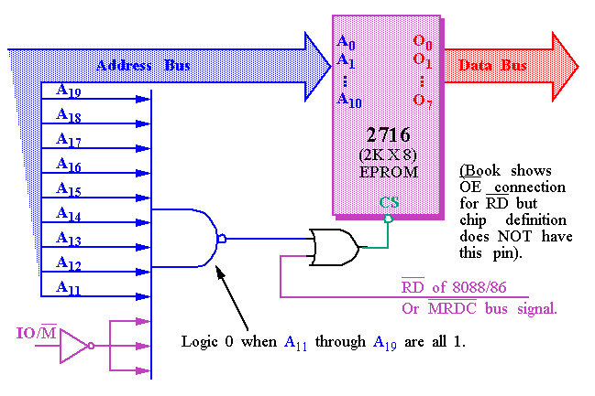
Lecture
SLIDE 6 / 10
Address Decoding Logic
1
Address decoders convert binary address signals into chip select signals for specific devices
2
Only one chip is activated at a time based on the unique address provided
3
Partial decoding may lead to address aliasing where multiple addresses access the same chip
4
Full decoding ensures every address maps to exactly one unique physical location
5
Decoders use logic gates like AND, NAND, and NOT to generate select signals
Memory Address Decoding (source: ece-research.unm.edu)
Chandigarh University
6 / 10
Notes:
The address decoder is the traffic controller of the memory system. It looks at the address lines and activates only the specific chip that holds the requested data. Without full decoding, you might encounter aliasing, where different addresses point to the same location, causing data corruption. This logic is fundamental to reliable memory access.

Slide 7
Lecture
SLIDE 7 / 10
Memory Connection Architecture
1
Memory connection involves linking address, data, and control buses to memory chips
2
Address lines connect directly to the chip's address pins for location selection
3
Data lines connect bidirectionally to transfer information between CPU and memory
4
Control lines like Read/Write and Chip Select manage the direction and timing of access
5
The connection must match the word size of the memory chips to the bus width
Chandigarh University
7 / 10
Notes:
Connecting memory involves three main types of lines: address, data, and control. The address lines tell the chip which location to access, while data lines carry the actual information. Control lines like Read/Write ensure data flows in the correct direction at the right time. Proper alignment of word size is essential for efficient data transfer.

Slide 8
Numerical Example
SLIDE 8 / 10
Address Calculation
EXAMPLE
Address 0x1000 selects the second 4KB block starting at 0x1000
• To map 4KB of memory, we need 12 address lines since 2¹² equals 4096
• If the base address is 0x0000, the range extends to 0x0FFF for 4KB
• For a 16KB block, we require 14 address lines because 2¹⁴ equals 16384
• The chip select signal activates when the upper address bits match the block range
Chandigarh University
8 / 10
Notes:
Let's calculate the address lines for a 4KB memory block. Since 2 to the power of 12 is 4096, we need 12 lines. If the base is 0x0000, the range ends at 0x0FFF. For a larger 16KB block, we need 14 lines. This calculation helps us design the decoder logic to select the correct memory chip.

Slide 9
Lecture
SLIDE 9 / 10
Key Takeaways
1
Memory address maps assign unique ranges to each device to prevent conflicts
2
Memory-mapped I/O integrates peripherals into the main address space
3
Address decoders use logic gates to activate specific chips based on address bits
4
Full decoding eliminates aliasing and ensures precise data location
5
Calculating address lines requires determining the total number of bytes needed
Chandigarh University
9 / 10
Notes:
To summarize, remember that address maps are essential for unique device identification. We distinguished between memory-mapped and isolated I/O, noting the trade-offs in each. Address decoders are the key to selecting the right chip, and full decoding prevents errors. Finally, always calculate the required address lines based on the memory size.

Slide 10
Lecture
SLIDE 10 / 10
References
COMPUTER ORGANIZATION AND DESIGN
The Hardware/Software Interface — David A. Patterson, John L. Hennessy
COMPUTER ARCHITECTURE
A Quantitative Approach — John L. Hennessy, David A. Patterson
• Computer Organization and Architecture — William Stallings
• Computer System Architecture — M. Morris Mano & Rajib Mall
• Computer Organization — Carl Hamacher, Zvonko Vranesic, Safwat Zaky
Chandigarh University
10 / 10
Notes:
These five textbooks provide the foundational knowledge for the concepts discussed today. Stallings and Mano offer excellent insights into architecture and organization. Patterson and Hennessy provide a quantitative approach to design. Hamacher's text is also a standard reference for understanding memory and I/O systems. Please refer to these for deeper study.

